Slide 1
ParkNow Assignment
Luiz Fernando Dias Rezende

Slide 2
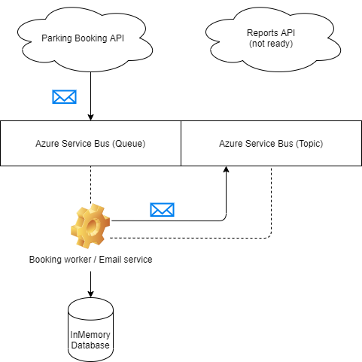
How is the architecture now

Slide 3
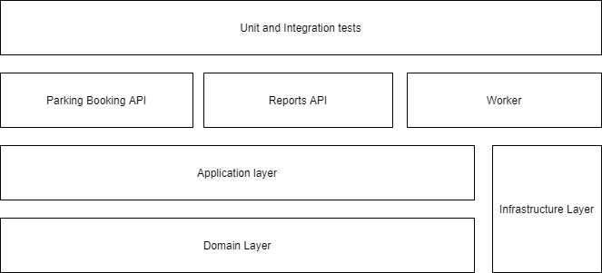
Layers

Slide 4
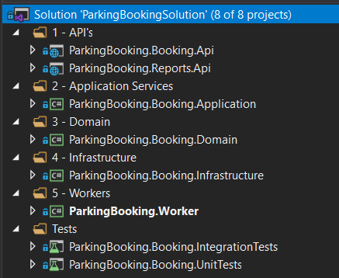
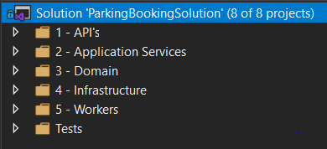
Solution

Slide 5
Todo's
Develop report feature
Add documentation for API's (Swagger)
Implement validations of the API contracts and commands
Improve the instrumentation
Improve the exception handling
Change the InMemoryDatabase for a real database
Build Email Service Worker
Increase the test code coverage, since currently only the domain and the api have tests
Add docker compose for initialization of all containers

Slide 6
Nice to have
Feature for garage availability (days and period the garage will be open)
Feature to tell the customer about other parkings available
Report that shows the parking peak time

Slide 7
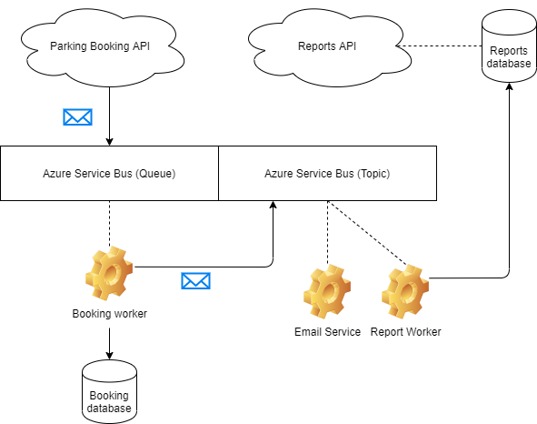
Pushing further...

Slide 8


